Slide 1
SUMO Simulation (a quick review)
Byron Mason

Slide 2
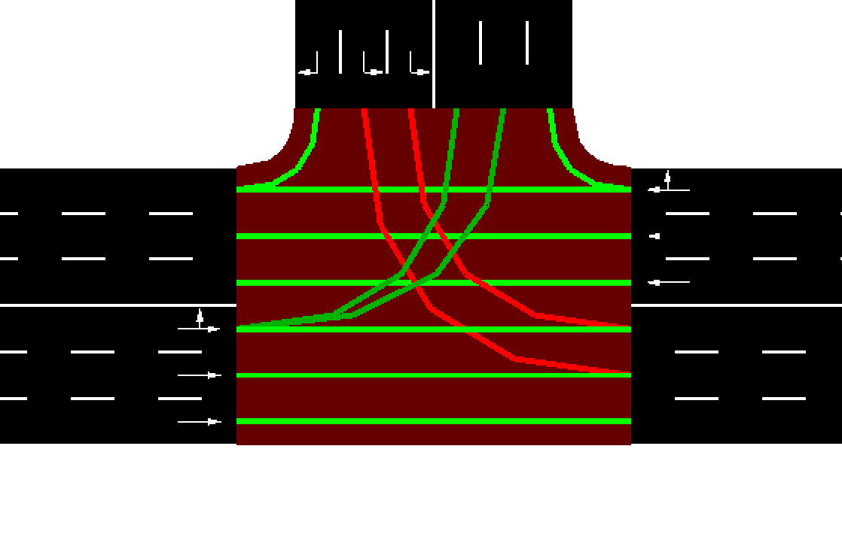
Setup
L15
L16
Simple T junction
No right turn on red
Right turn on red
Four vehicle types
pkw
bus
bike
scooter
Traffic flows
L15 to L13 and L18
L14 to L16 and L18
L17 to L13 and L16
L13
L17
L14
L18

Slide 3
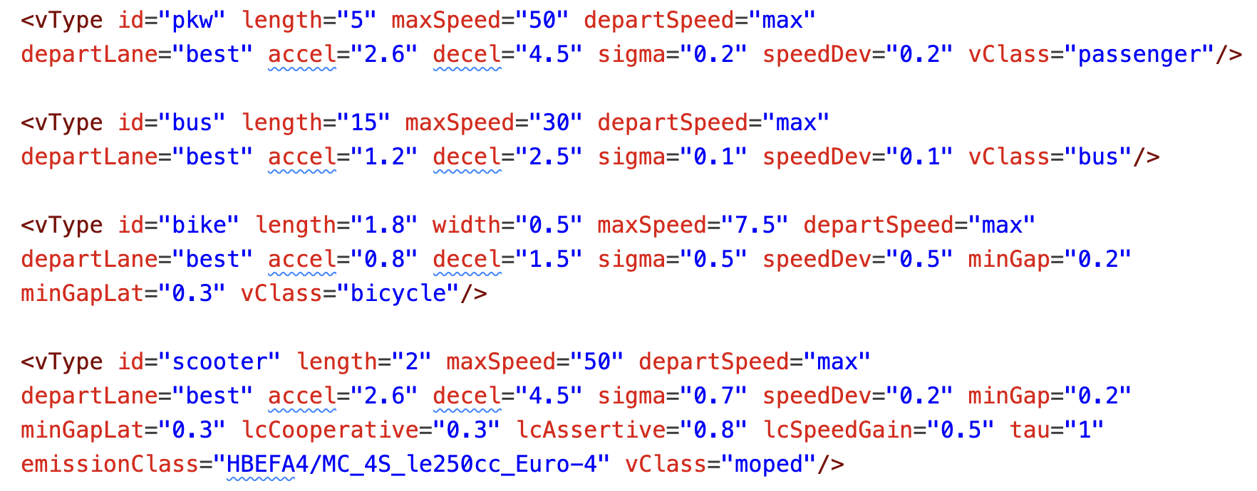
Setup
Vehicles are defined as follows

Slide 4
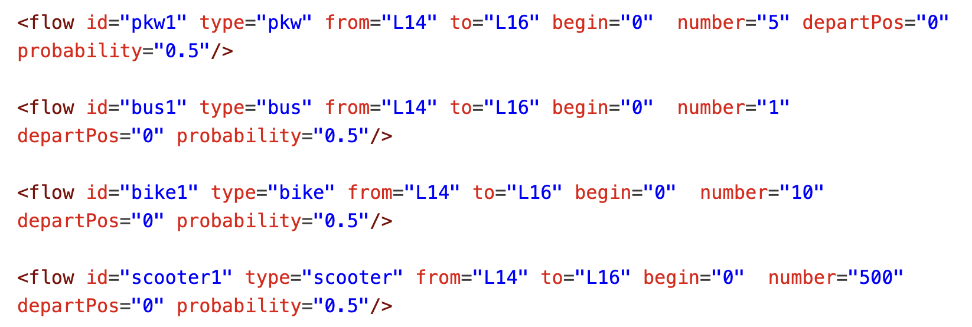
Setup
Routes are defined as follows

Slide 5
Setup
For each flow the number of vehicles is
pkw (5)
bus (1)
bike (10)
scooter (500)
Simulation is run for 600 seconds
Emissions model is used to output CO2, CO, HC, NOx, PMx and fuel consumption at every timestep (HBEFA3, HBEFA4)
Python script is used to add all of the emissions across all of the vehicles
Note emissions output from bike is 0.

Slide 6
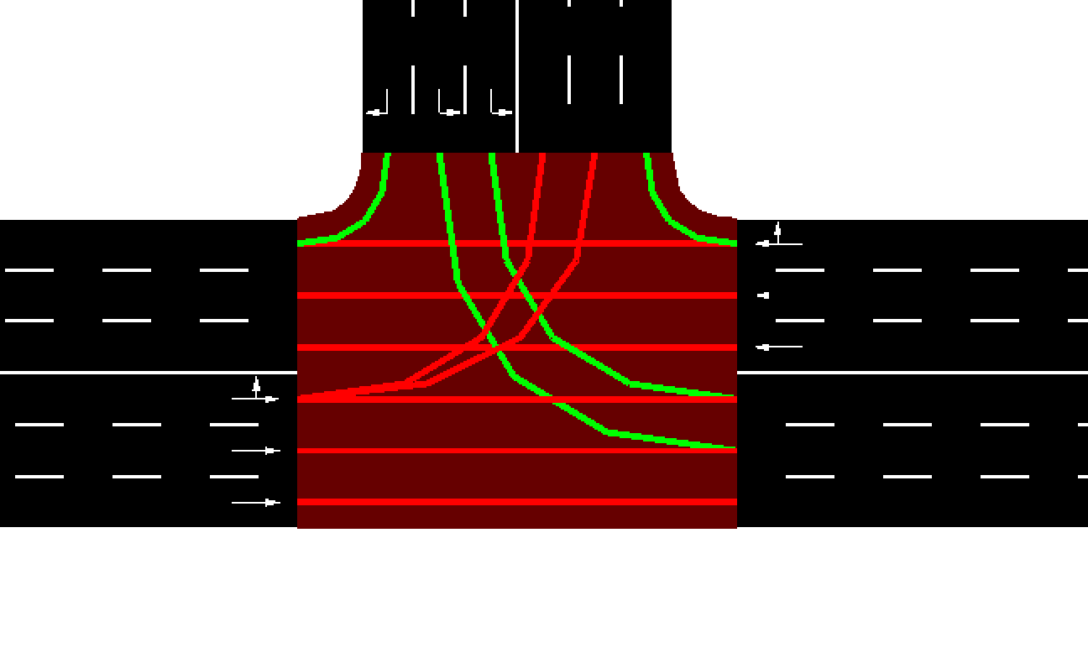
Simulation Results - Right turn on red
CO2 (mg) - 79153877
CO (mg) - 890638
HC (mg) - 56037
Nox (mg) - 149915
PMx (mg) - 32182
Fuel (mg) - 25483976

Slide 7
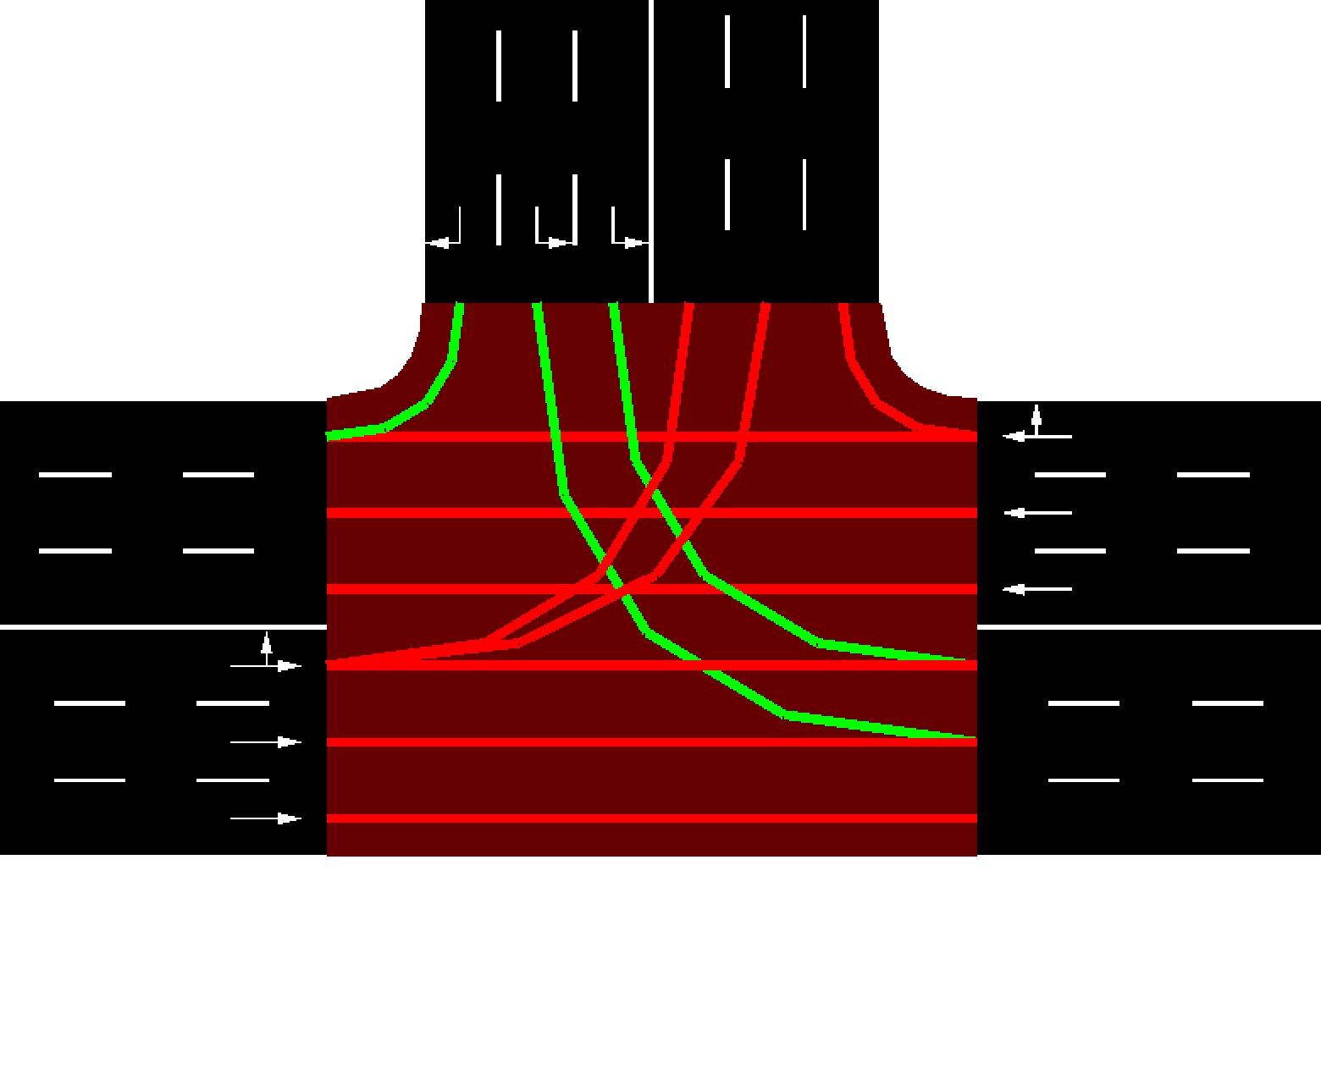
Simulation Results - No right turn on red
CO2 (mg) - 81354980
CO (mg) - 915166
HC (mg) - 55975
NOx (mg) - 153109
PMx (mg) - 33939
Fuel (mg) - 26192613

Slide 8
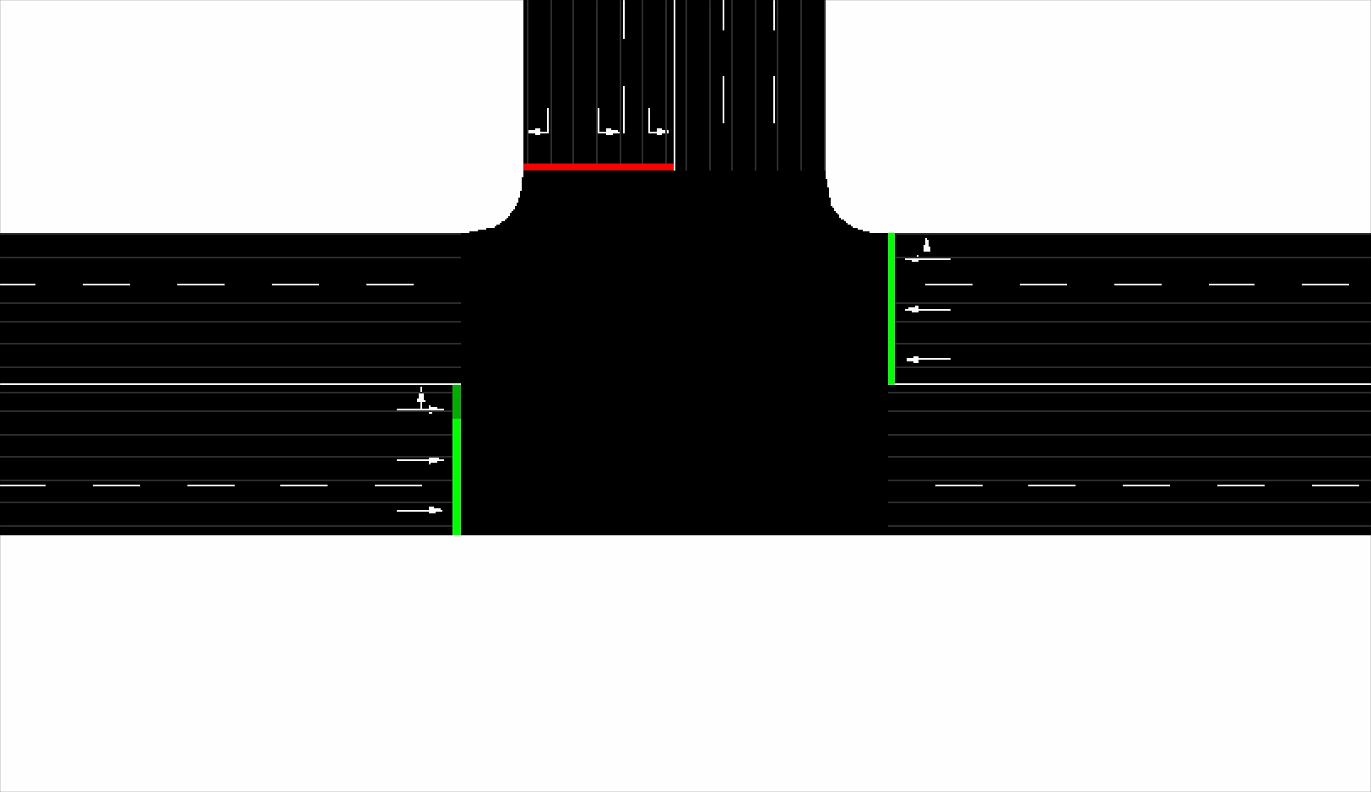
Simulation Results

Slide 9
Simulation Results - Comparison
Results show up to 5% difference due to change in turn rules (PMx)
Results normalised due to large difference in magnitude across emissions species

Slide 10
Simulation Results – Changing fleet composition
Number of vehicles in each class for each flow was changed whilst keeping the total number of vehicles the same.
No right turn on red was enforced
Run 1: pkw (5), bus (20), bike (10), scooter (480)
Run 2: pkw (100), bus (25), bike (10), scooter (380)
Run 3: pkw (15), bus (100), bike (20), scooter (380)
Run 4: pkw (380), bus (100), bike (20), scooter (15)

Slide 11
Simulation Results
Interesting results since pkw(5), bus(1), bike(10), mbike(500) shows significantly lower emissions across all species (this was the case presented previously)

Slide 12
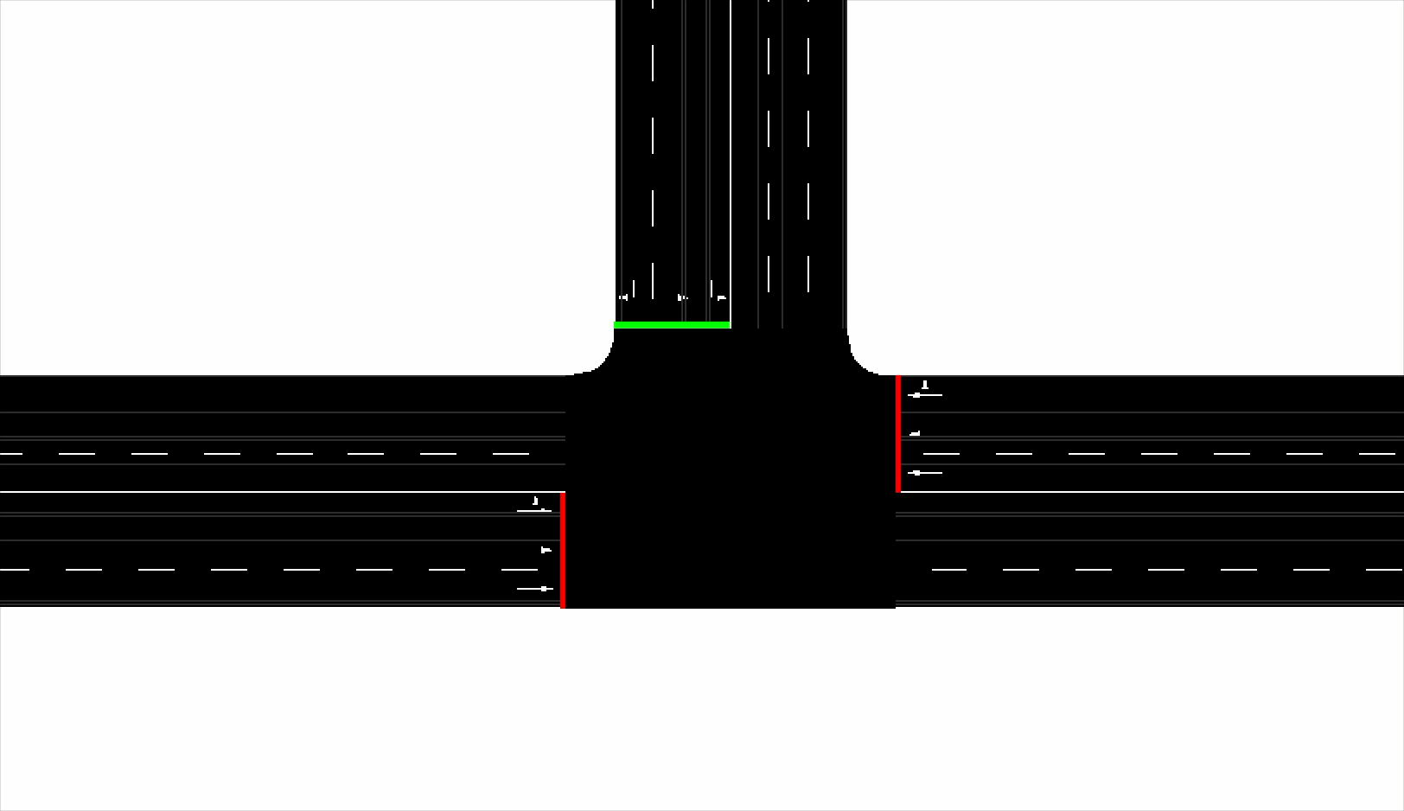
Simulation Results
pkw (15), bus (100), bike (20), mbike (380)

Slide 13
Observations
Simulation shows sensitivity to fleet composition and turn rules which is a good start
The magnitude of the difference appears significant however some further validation of expected emissions levels should be investigated
Results obtained for fleet composition study are unexpected in that the first run shows significantly lower emissions which should be investigated. This could be due to low bus numbers. 1 in the first run compared with 20, 25, 100, 100 in subsequent runs

Slide 14
Observations
Parameters of scooter vehicle class were changed to reflect Vietnamese driving style but this is currently not based on any observational data and likely therefore not a true reflection. Lane discipline behaviour for example doesn’t appear correct.
Simulation is quick to run through GUI but automation will help speed things up.

Slide 15
Future Work
Need to develop code to automate simulation and results acquisition / processing.
Should also consider interface with MBC for simulation parameter setting and importing of simulation results for model creation.
Vietnamese driving behaviour needs to be considered and characterised in the simulation
Emissions classes selected for vehicles should be based on some level of fact
Need to incorporate some measure of how traffic is affected (beyond emissions) by input factors e.g. wait time
Traffic flow rates and fleet composition needs to be considered
It is not clear how SUM places the different vehicles in the simulation and this should be investigated

Slide 16
Future Work
The simple T junction is a good starting example, but work should begin on characterising a real junction since behaviour is likely to be more complex
Fleet composition at real junction should be based on available evidence (or observation)
Need to consider which factors to include in screening experiment

Slide 17
Notes – Vehicle Types
Vehicle types are fixed but may vary as more cars are brought into the fleet. This will likely reduce the number of scooters.
Vehicle type study is a prediction of what will happen in the future as a consequence of external factors and does not consider what can be done today in terms of road layout etc (internal factors)
Policy changes which are internal factors could incentivise the use of public transport over scooters
The study should perhaps focus on internal factors such as
Traffic light timing
Lane rules
There is a problem in creating a surrogate model of continuous vs discrete variables

